Slide 1
Designing Message Passing Protocols for Decentralised Multi-Agent Reinforcement Learning
By Will Bailkoski

Slide 2
The Problem
Predict the state of an entity within a dynamic system
N sensors take measurements with a “latency-accuracy trade-off”
Central computer estimates the position of the entity with the measurements
An error is derived from a Kalman Predictor with delayed updates

Slide 3
The Motivation
As the number of sensors increases, the computational burden on the central computer increases. Exponential blowup.
Idea: decentralise the decision-making
Issue: with a decentralised model, agents do not converge a policy

Slide 4
Technical Features
A message passing protocol that effectively communicates the joint action space
This uses a leader-explorer structure
A leader agent orders other agents to explore the action space, and communicates whether the exploration has been more successful than the current policy
This is the novel contribution of my project

Slide 5
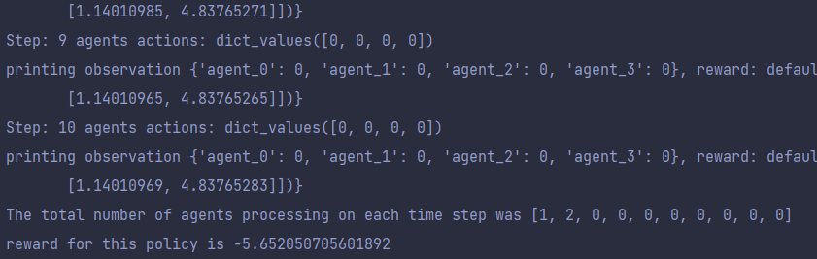
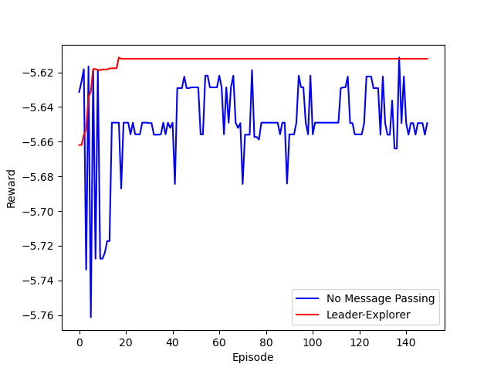
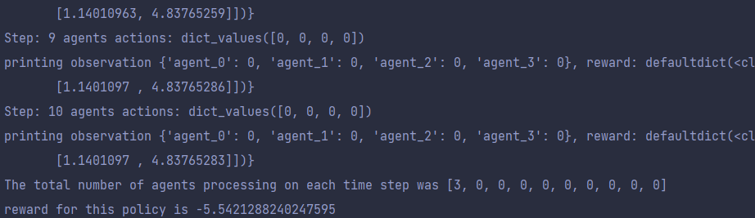
Test Results
No message passing
Leader-Explorer

Slide 6
Evaluation
There needs to be some work on the reward function
Most notably the long-distance dependencies between time frames
Arguably, this model is not fully decentralised.
The long-term goal of this project would eventually be to move the entire Kalman Predictor to individual agents.

